Slide 1
B+ trees

Slide 2
Outline
Motivation:
Hard drives accesses are slow
Reduces the number of disk accesses
B+ trees:
Description
Insertion and deletions

Slide 3

Hard Drives
Main memory is limited: MiB-GiB
Caches even more so: KiB-MiB
Hard drives, however, are rich: GiB-TiB
The cost is speed...
Platters spin at
3600-7200 rpm
Hewlett-Packard http://www.hp.com/

Slide 4
Hard Drives
Recall:
1 kB = 1000 bytes 1 KiB = 2¹⁰ bytes = 1 024 bytes
1 MB = 10⁶ bytes 1 MiB = 2²⁰ bytes = 1 048 576 bytes
1 GB = 10⁹ bytes 1 GiB = 2³⁰ bytes ≈ 1.073 · 10⁹ bytes
1 TB = 10¹² bytes 1 TiB = 2⁴⁰ bytes ≈ 1.100 · 10¹² bytes

Slide 5
Hard Drives
Access time for these devices is variable:
Cache 1 GHz
Main memory (SDRAM): 100 MHz
Hard drive (10 ms seek time) 100 Hz
A factor of ten million

Slide 6
Hard Drives
Consider the one second it takes to retrieve a book from a bookshelf
In 10⁷ s (four months):
Walk from Waterloo to Ottawa
Pick up a book in the National Archives, and
Walk home with months to spare

Slide 7

Hard Drives
No wonder Marvin the Paranoid Android is always bored when he deals with humans
1 Hz
10 Hz if typing
Copyright © 1982 by the B.B.C.

Slide 8
Hard Drives
Main memory (in general) is byte addressable
Each byte has its own address
Each byte can be accessed or modified
To access a bit, you must access the byte containing it

Slide 9
Hard Drives
Hard drives are block addressable
The block size is variable
We will assume blocks are 4 KiB
To access a byte from a block, you must load the entire block containing it

Slide 10
Hard Drives
The I/O controller on the hard drive reads and writes to the hard drive in blocks
The block is copied to main memory
Direct memory access (DMA)
To access one byte on the hard drive, the controller loads the entire 4 KiB block

Slide 11
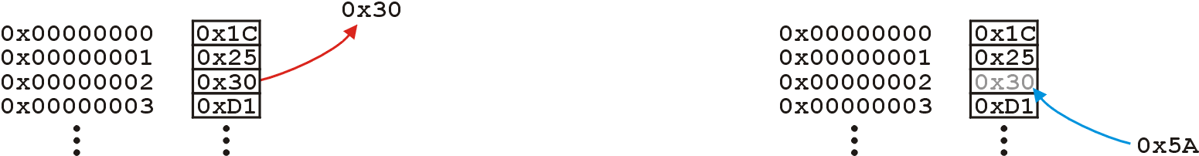
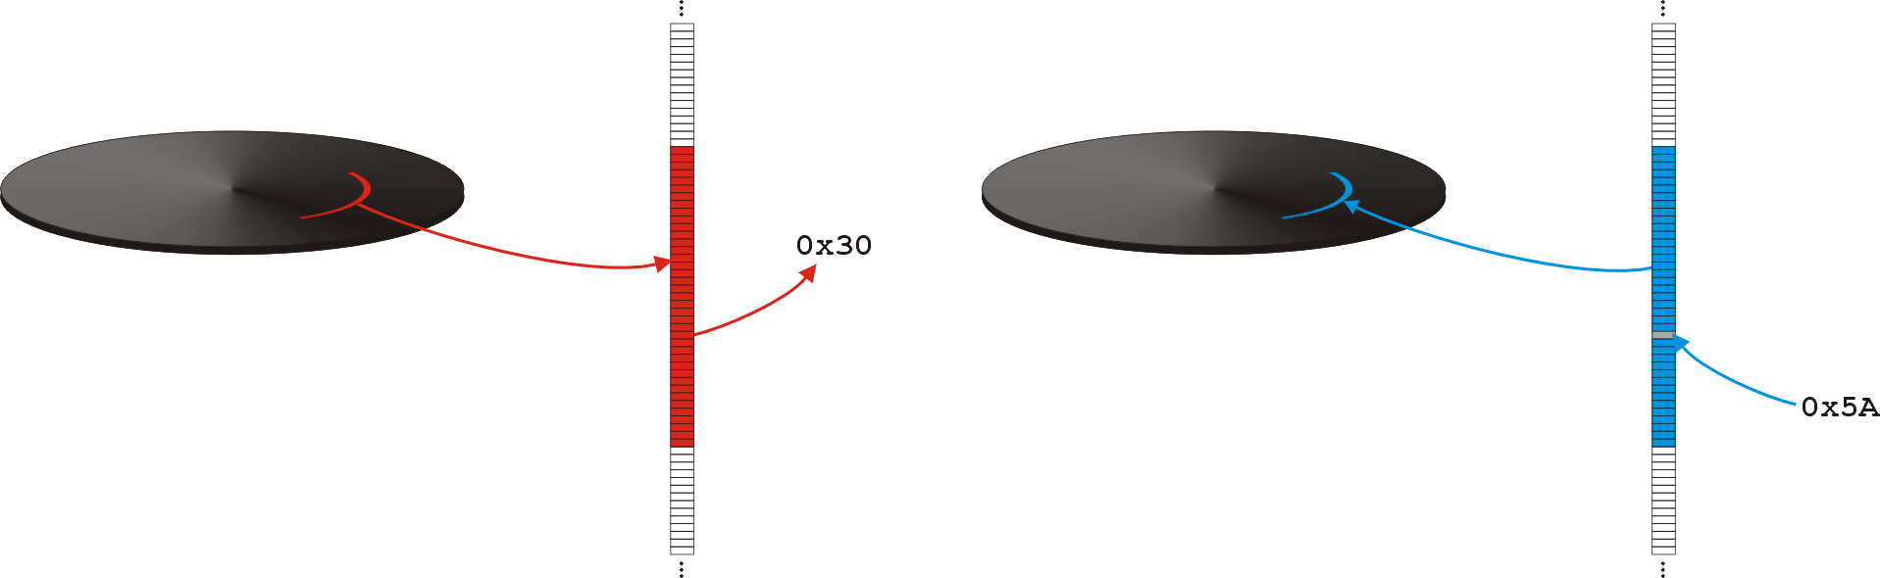
Hard Drives
Accessing/modifying a byte in main memory:
Accessing/modifying a byte on a hard drive:
Main memory
Main memory
Hard drive
Hard drive
Main memory
Main memory

Slide 12
Hard Drives
When you format your hard drive, you specify the block size
All files occupy an integral number of blocks
The last block may be part empty

Slide 13
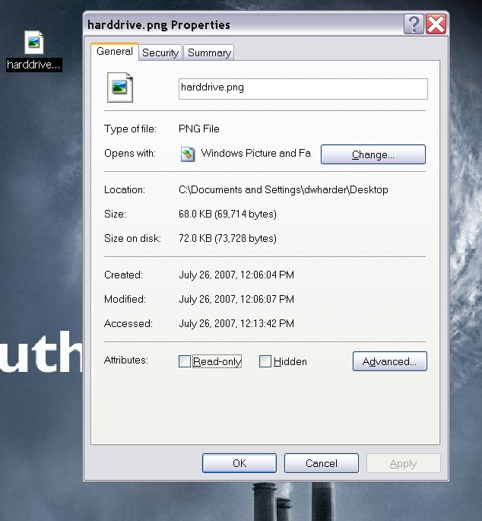
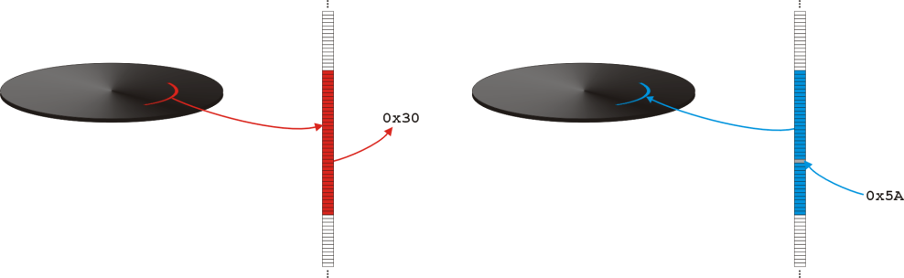
Hard Drives
For example, the previous image of the hard drive occupies 69 714 bytes
Requires 18 4-KiB blocks 18 × 4098 bytes = 73 728 bytes

Slide 14
Hard Drives
Consequence: 4014 bytes are unused
Large block sizes will waste space

Slide 15
Hard Drives
In summary:
Hard drives are slow
Divided into blocks
We will use a 4 KiB block size
Accessing the entire block costs the same as accessing one byte within the block

Slide 16
Storing Very Large Trees
Problem:
Suppose we are attempting to store a large amount of ordered data
We will consider 10⁹ items
A 4-byte (well ordered) key and associated data
Pointers assumed to be 4 bytes

Slide 17
Storing Very Large Trees
Restrictions and Assumptions:
This must be stored on a hard drive
32 bits only access 4 GiB
Main memory is volatile
Assume the root node is in main memory
Block addresses are 32 bits
Processor speed: 3 GHz
Hard drive seek time: 10 ms

Slide 18
Storing Very Large Trees
We have assumed that all balanced trees are comparable: Θ(ln(n))
This will not always apply
Consider
Binary search trees
M-way trees
Realistic M-way trees
B+ trees

Slide 19
Binary Search Trees
A binary search tree with 10⁹ entries has a minimum height of ⌊lg(10⁹)⌋ = 29
Just the pointers requires almost 8 GiB
32 bits can access at most 4 GiB of main memory

Slide 20
Binary Search Trees
It is very likely that two nodes are not in the same block on the hard drive
Accessing leaf node requires that 29 blocks be copied from the hard drive
Assume the root is in main memory
With 10 ms seek time, this would require approximately 0.29 s

Slide 21
M-Way Search Trees
Let us try to fit as many keys and pointers into one block
Keys are 4 bytes
Assume pointers are 32 bits (4 bytes)
A block is 4 KiB:
4 KiB / (4 bytes + 4 bytes) = 512
Store a 512-way node in each block

Slide 22
M-Way Search Trees
An optimal 512-way tree would be of height ⌊log₅₁₂(10⁹)⌋ = 3
Searches requires at most 30 ms
Almost 10 times faster than a binary search tree

Slide 23
M-Way Search Trees
Problem:
We are only storing keys and pointers
That’s like storing
UW Student IDs
Bank account numbers
but no information
In general, we want to store more information...

Slide 24
M-Way Search Trees
Assume we wish to store:
a 4 byte key
a 4 byte pointer (to a child block), and
100 bytes of information
Consequently
Each block can store 37 records
Use a 38-way tree

Slide 25
M-Way Search Trees
A 4 KiB block would be partitioned as follows:
37 records with keys
38 next pointers
96 bytes left over
4096 B

Slide 26
M-Way Search Trees
Hence, the maximum height would be
⌊log₃₈(10⁹)⌋ = 5
This would increase search time by 67% over a 512-way tree

Slide 27
M-Way Search Trees
Problem:
We don’t want to increase the run-time
Recall that 31/32 ≈ 97% of all records are already in the leaves
Solution:
Move all data (4-byte key and100 bytes per record) into the leaves

Slide 28
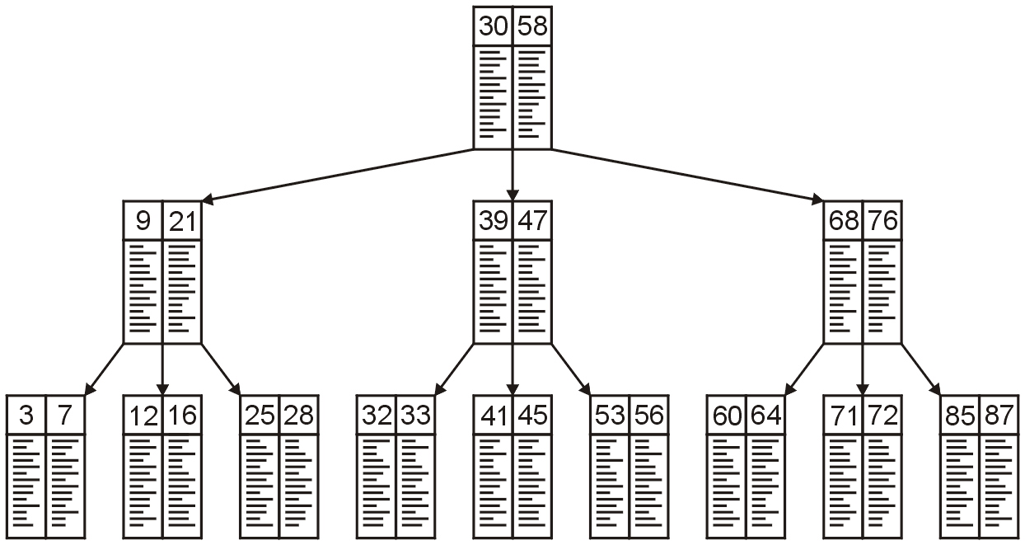
M-Way Search Trees
Consider this 3-way tree
Integer keys and data

Slide 29
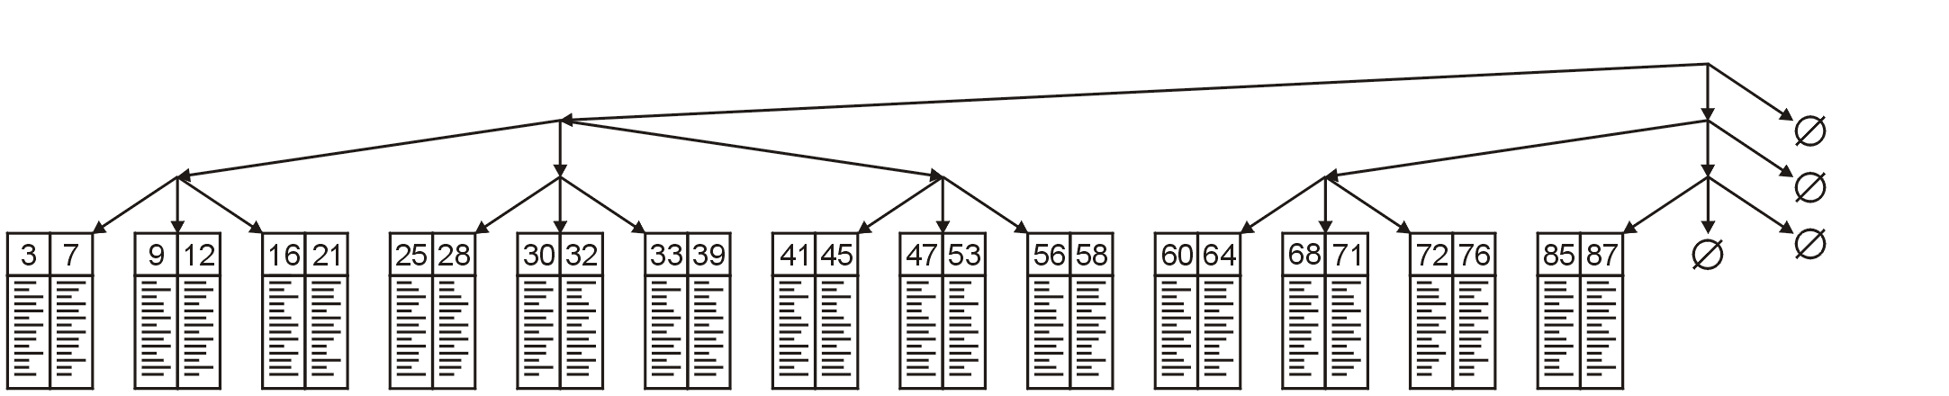
M-Way Search Trees
Move all data to the leaves
We must still know which leaf to access

Slide 30
M-Way Search Trees
For example, we could store the minimum and maximum values in each tree
Expensive...

Slide 31
M-Way Search Trees
Instead, recall that our goal is to make each node (leaf or internal) fit into one block (e.g., 4 KiB)
If we are not storing data, we can store more keys and pointers
Let the internal nodes be M-way trees where

Slide 32
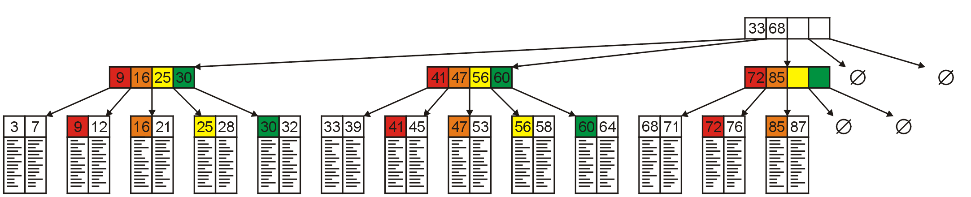
M-Way Search Trees
We could use a 5-way tree
Store the smallest entries of all but the first sub-tree

Slide 33
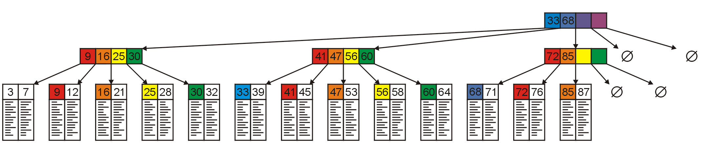
M-Way Search Trees
We can do this at all levels

Slide 34
M-Way Search Trees
Searching is now straight-forward:
Find entries 28 and 63

Slide 35
B+ Trees
A B+ tree uses this idea
Adds restrictions to ensure balance and consistency
The goal is to:
Minimize disk accesses
Fix access time
Data is stored in leaf nodes and internal nodes are M-way trees

Slide 36
B+ Trees
The block size will affect:
The amount of data stored in leaf blocks
The choice of M for the internal blocks
Maximize the amount of data which can be stored in one 4 KiB block

Slide 37
B+ Trees
Suppose our key is 4 bytes and we are storing 100 bytes per record
Thus, our leaf blocks will store 39 records with 40 bytes left over
4096 B

Slide 38
B+ Trees
Next, we must represent store the internal blocks
Because all information is in the leaf blocks, we only need to store:
Keys (to allow navigation) and
Pointers

Slide 39
B+ Trees
Thus, within a 4 KiB block, we could store 512 key-address pairs
This allows us to use a 512-way tree
The 4 bytes left over could store the number of entries
Not all internal blocks will be full
4096 B

Slide 40
B+ Trees
One billion records requires
10⁹/39 = 25 641 026 leaf blocks
A 512-way tree of height h can store 512^{h + 1} entries in the deepest nodes
Including the links to the leaf nodes, the tree height is h = 3

Slide 41

B+ Trees
Any search would require three disk accesses, or 30 ms
The root is always in memory
We search for the required child

Slide 42

B+ Trees
Loading the child requires 10 ms
A search indicates which child to access

Slide 43
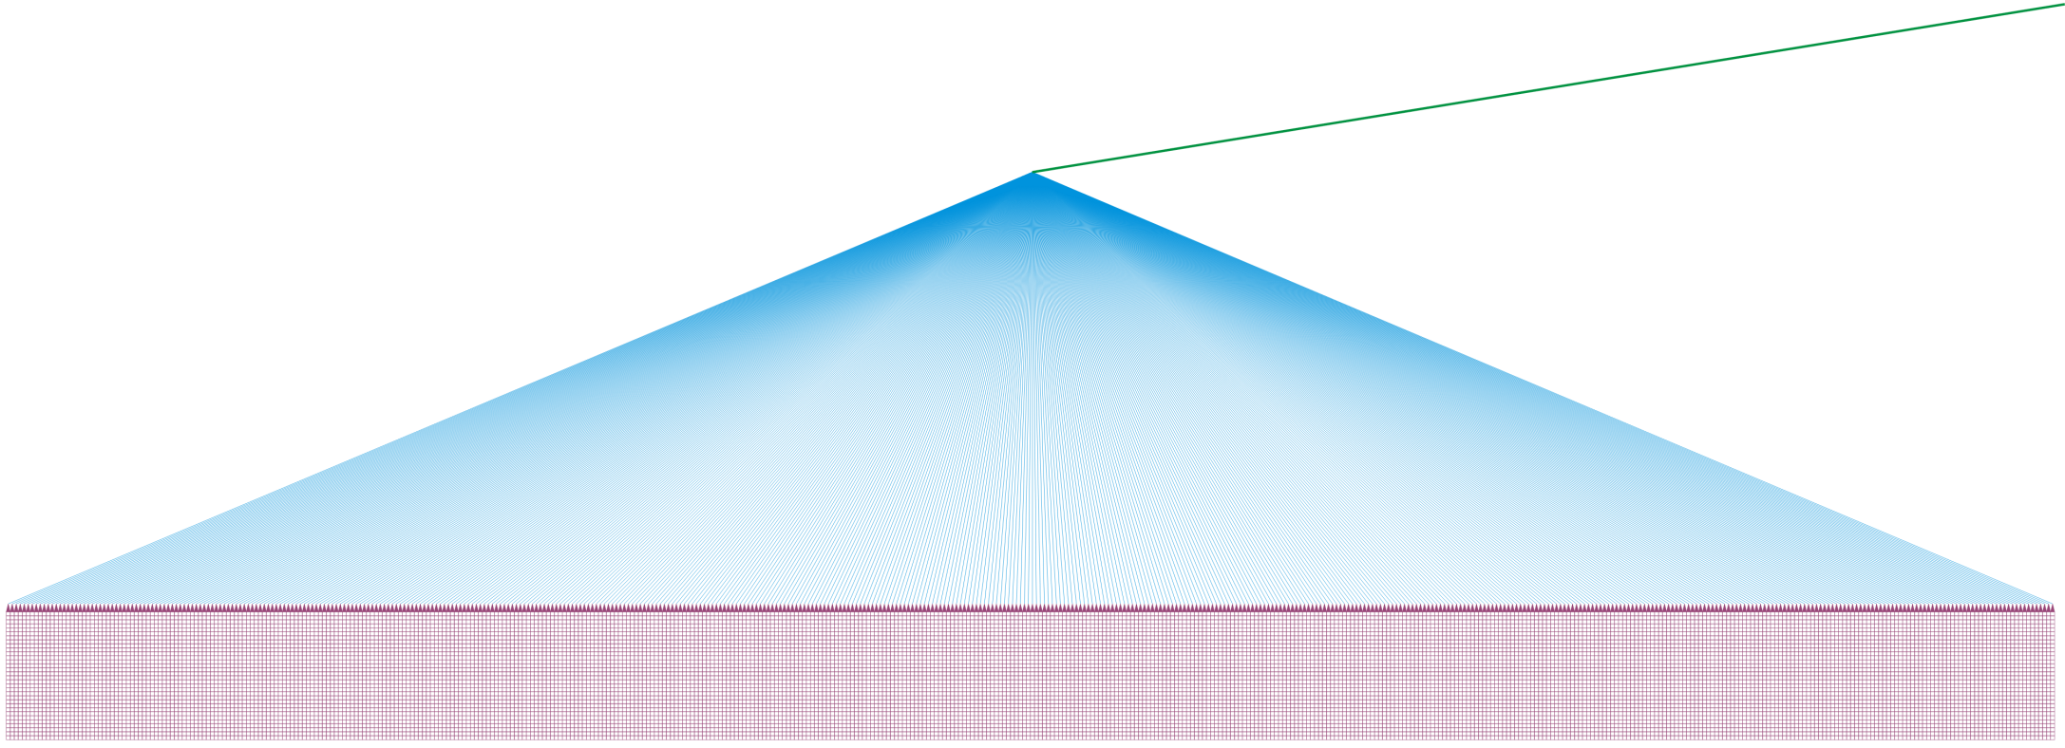
B+ Trees
The 2nd level requires another 10 ms to load
A search indicates which leaf block to load

Slide 44

B+ Trees
Finally we load the leaf block: 10 ms
Search the 39 records for the one of interest

Slide 45
B+ Trees
A B+ tree is a tree where
All the leaf blocks are arrays with L records sorted on a key
All internal blocks are M-way trees with M – 1 keys and M sub-trees

Slide 46
B+ Trees
This defines the general shape of a B+ Tree
We will require that all leaf blocks are at the same height
Guarantees the same access time for all records

Slide 47
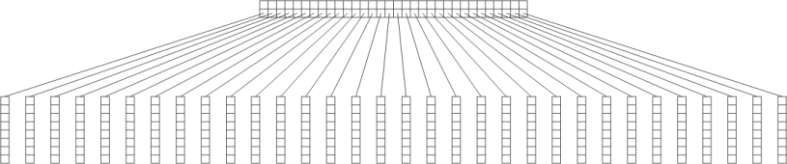
B+ Trees
A B+ trees of height 1 and 2 with
32-way internal blocks M = 32
8 records per leaf blocks L = 8
32-way trees
leaf blocks: L = 8

Slide 48
B+ Trees
These images show perfect B+ trees
Best possible case
256 records
8192 records

Slide 49
B+ Trees
In most cases the nodes will not be full
Partially filled leaf blocks
Internal nodes with less than M sub-trees
A few additional rules ensure a reasonable balance

Slide 50
B+ Trees
Define a B+ tree of order M as follows:
All data is stored at the leaf blocks
If there are no more than L entries, the root node is a leaf block
Otherwise, all leaf blocks are
At the same depth
Contain between ⌈L/2⌉ and L entries
At least half full
L depends on the size of the records being stored and the size of the blocks

Slide 51
B+ Trees
The root nodes is either:
A leaf block, or
An M-way tree with between 2 and M children
All other internal blocks are M-way trees with ⌈M/2⌉ to M children
The internal blocks store up to M – 1 keys to guide the searching where key k represents the smallest key in sub-tree k

Slide 52
B+ Trees
The best case height for our example was:
Assuming the worst case
All child blocks are half filled (20), and
All internal nodes are half filled (256)
then the height of the tree is

Slide 53
B+ Trees
If we wanted to store 10 trillion entries with M = 512, L = 39
Best case:
Worst case:

Slide 54
B+ Trees
Recall that the our block size is fixed at 4 KiB
Consequently, we may consider any operations that manipulate these blocks to be Θ(1)
Technically the array manipulations are O(L) and O(M), but both L and M depend entirely on the block size
Thus, all operations will have the same run-time Θ(ln(n))
Note that unlike AVL trees, we must always access a leaf node

Slide 55
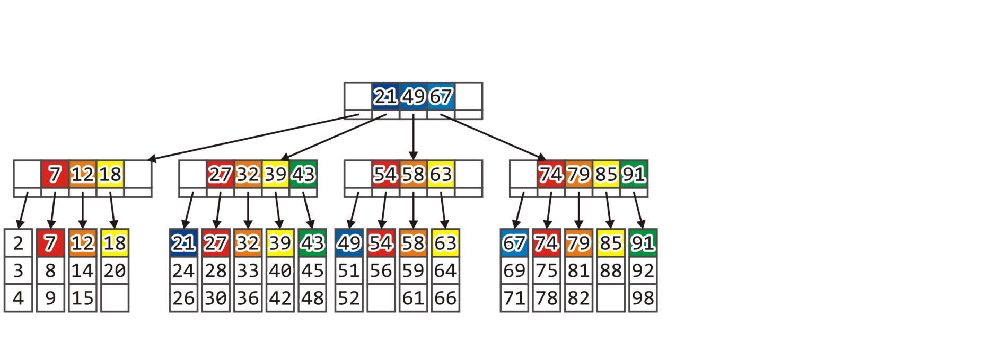
Example
Consider the following B+ tree
M = 5, L = 3 and 54 records

Slide 56
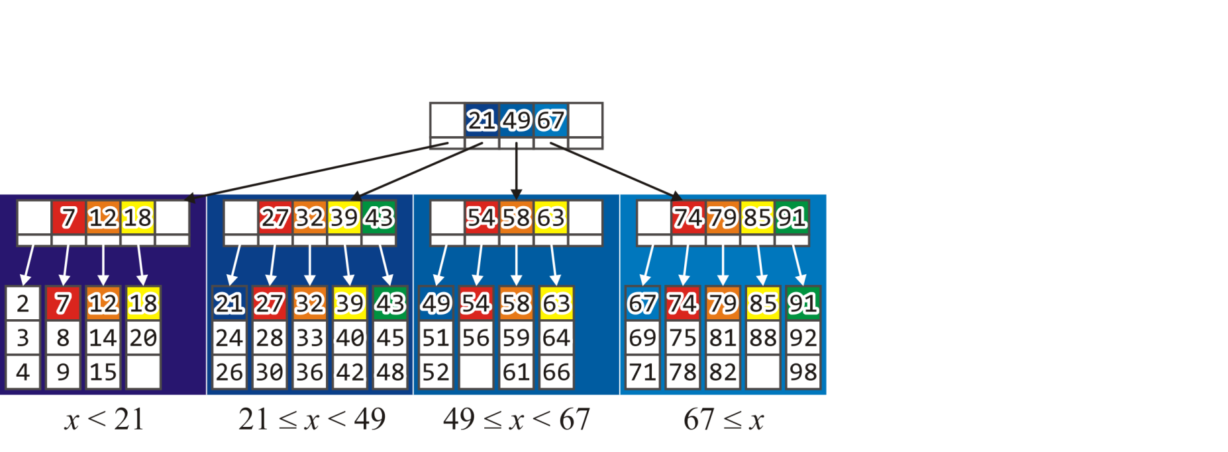
Example
The root node guides the search for keys:
The 1st subtree contains all objects x < 21
The 2nd, all objects 21 ≤ x < 49
The 3rd, all objects 49 ≤ x < 67 and
The 4th, all objects x ≥ 67

Slide 57
Find
Searching for 14:
14 < 21 check 1st subtree
12 ≤ 14 < 18 check 3rd leaf block

Slide 58
Find
Searching for 65:
49 ≤ 65 < 67 check 3rd subtree
63 ≤ 65 check 4th leaf block

Slide 59
Find
Searching for 71:
67 ≤ 71 check 4th subtree
71 < 74 check 1st leaf block

Slide 60
Find
The root node is always in main memory
Each find required that 2 blocks be loaded into main memory
Total time: 20 ms
If the associated record is modified, the leaf block must be saved
Total time: 30 ms

Slide 61
Insert
Suppose we insert a new record into the B+ tree
Follow the same search pattern as find
If the record is not in the corresponding leaf block, add it and save the block
If the leaf block is full, split it into two leaf blocks with the records split between the two nodes
Each leaf block is guaranteed to be at least half full
It is necessary to update the parent

Slide 62
Insert
Suppose we insert 55
49 ≤ 55 < 67 check 3rd subtree
54 ≤ 55 < 58 check 2nd leaf block

Slide 63
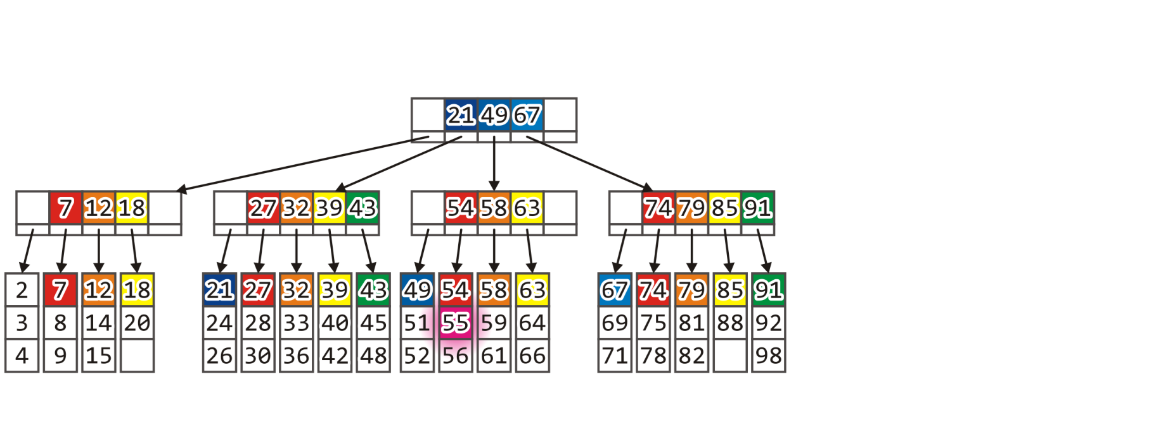
Insert
55 is not in this leaf block and the block is not full
We add it by doing an O(L) insertion into the array

Slide 64

Insert
The modified leaf block must now be saved to the hard drive

Slide 65
Insert
Next, insert 87
67 ≤ 87 check 4th subtree
85 ≤ 87 < 91 check 4th leaf block

Slide 66
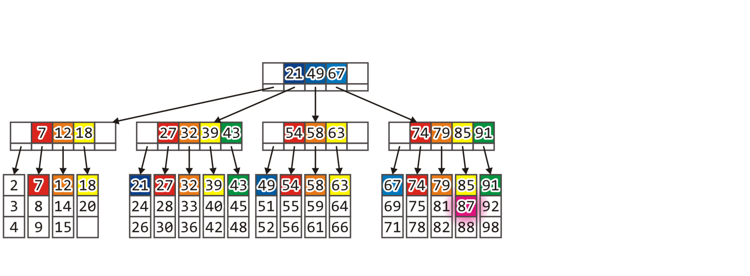
Insert
Again, the leaf block is not full, so we add it

Slide 67
Insert
As long as the corresponding leaf node is not full, insertion is similar to a find followed by a write
The insertion itself may be O(L), but this is trivial relative to the time required to perform even one write to the disk
Total time: 20 ms + 10 ms = 30 ms

Slide 68

Insert
Consider inserting 60

Slide 69
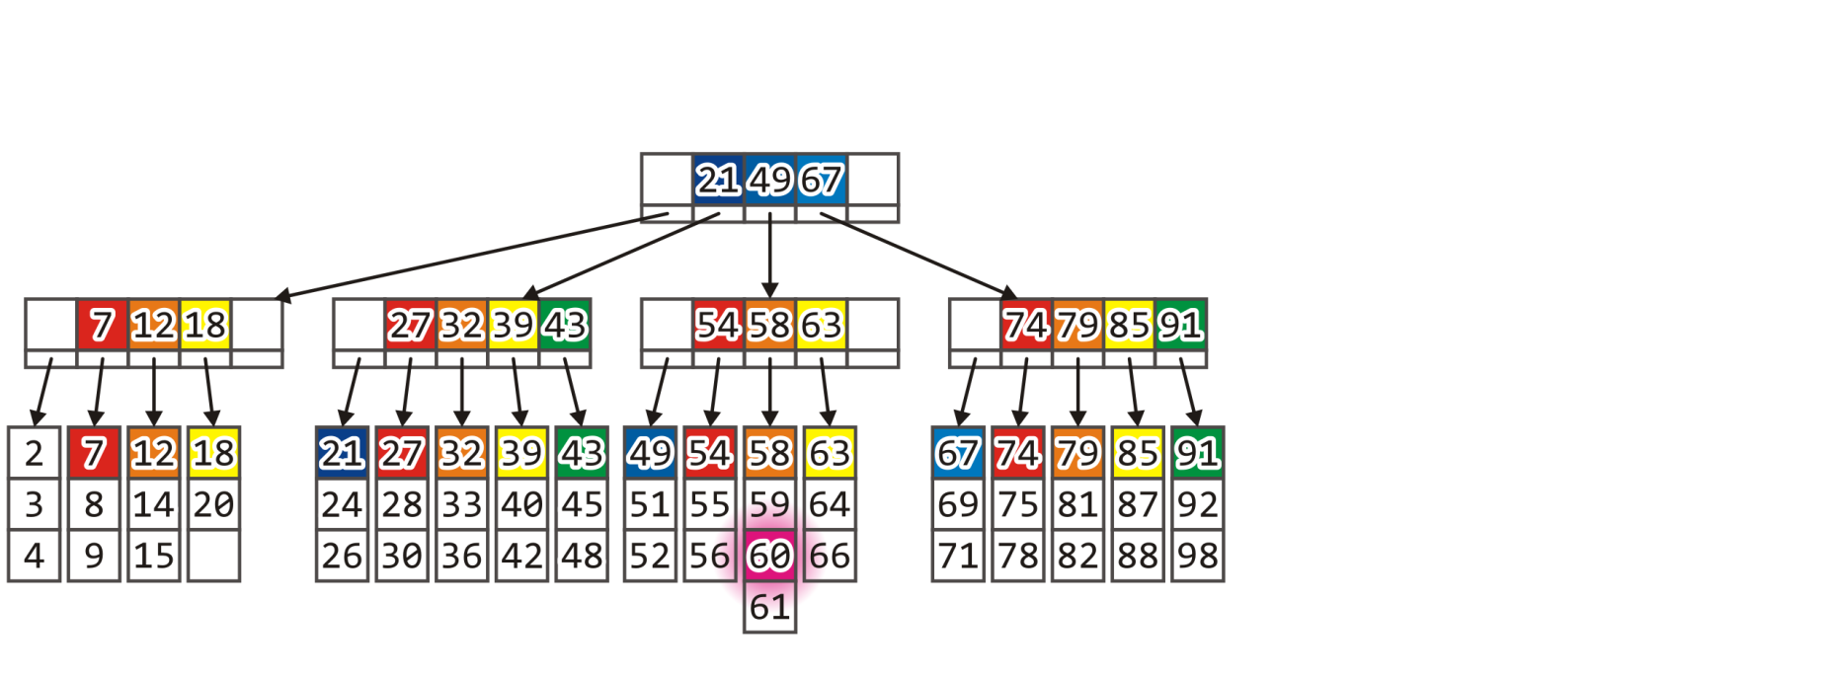
Insert
Consider inserting 60

Slide 70
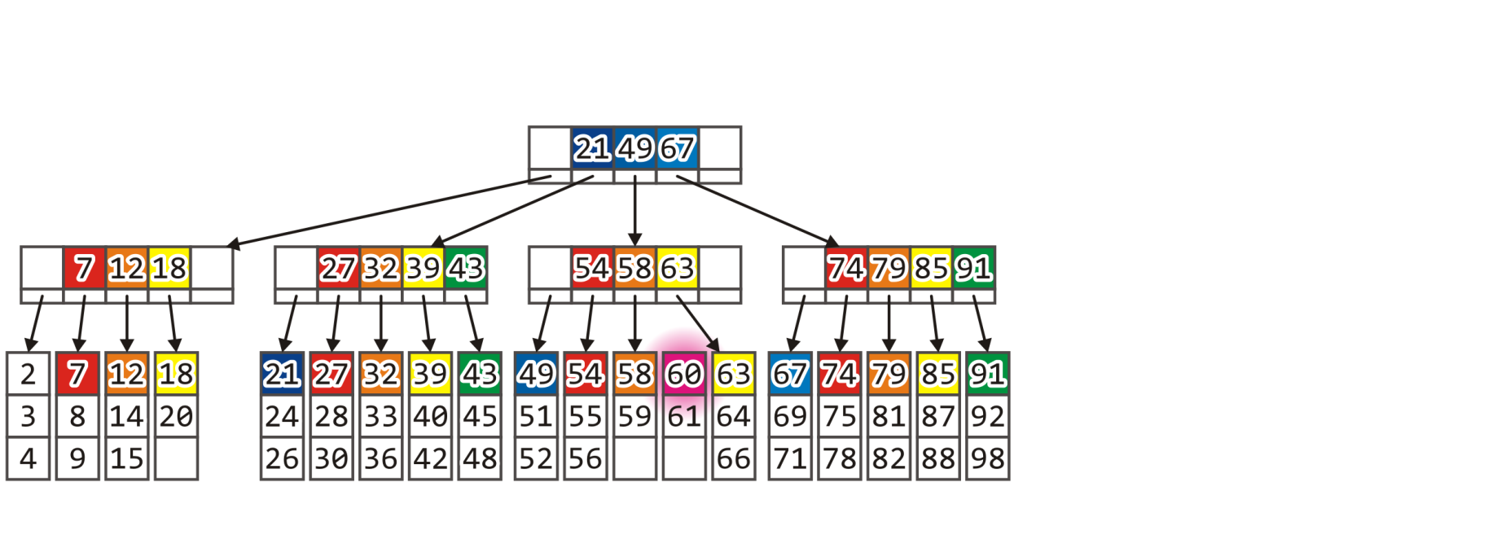
Insert
Both immediate siblings are full
Split the leaf block into two, each of which are at least half full

Slide 71
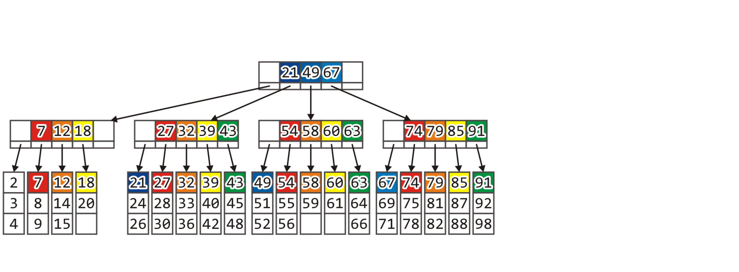
Insert
The parent must be modified to account for this new node:
Add 60 to the parent and update the pointers

Slide 72
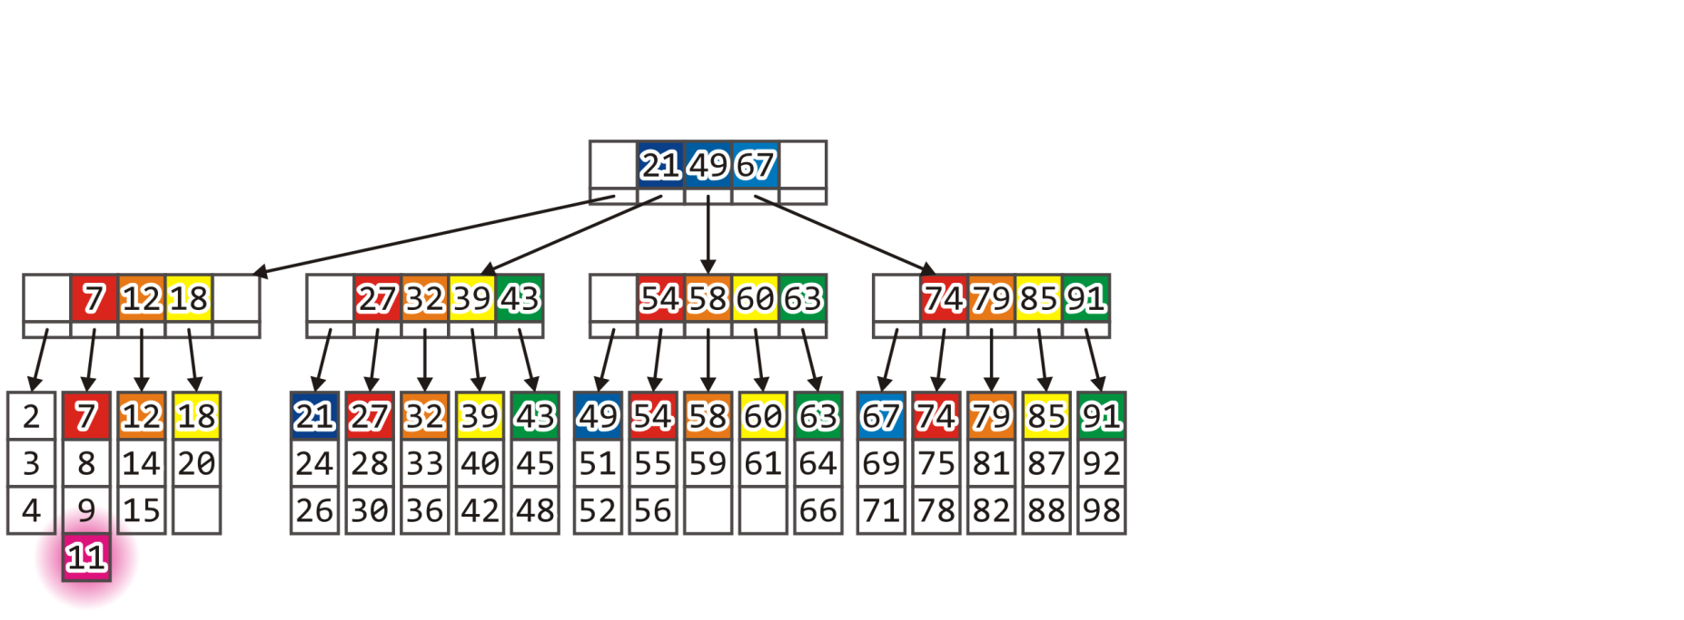
Insert
Consider inserting 11

Slide 73
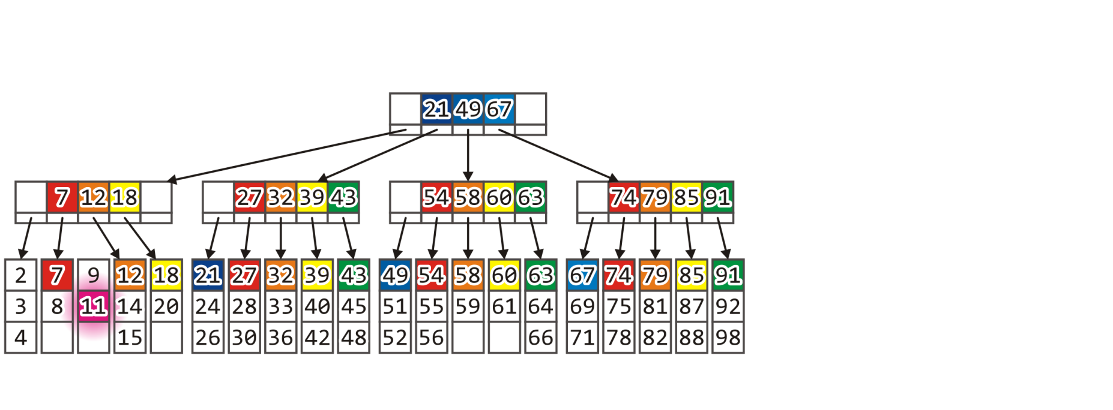
Insert
Both siblings are full, so split the leaf block

Slide 74
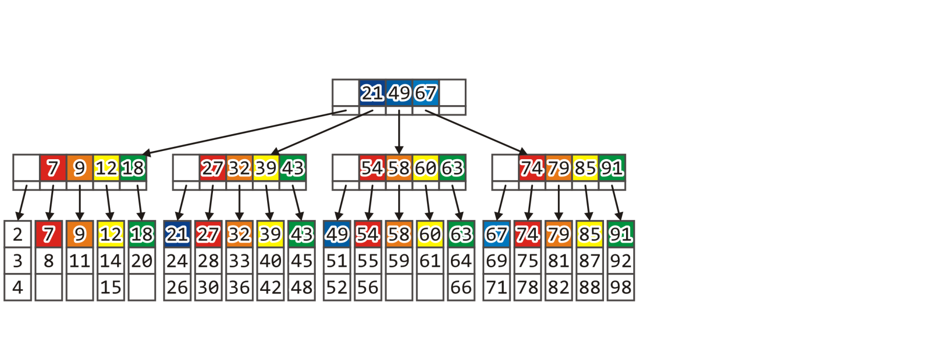
Insert
The parent must be updated to accommodate the new leaf block

Slide 75
Insert
In addition to loading the two blocks, it is now necessary to:
Save the modified leaf block,
Save the new leaf block, and
Save the parent.
Total time: 20 ms + 30 ms = 50 ms
Problem: what happens if the parent is full, too?
We must recurse back to the root

Slide 76
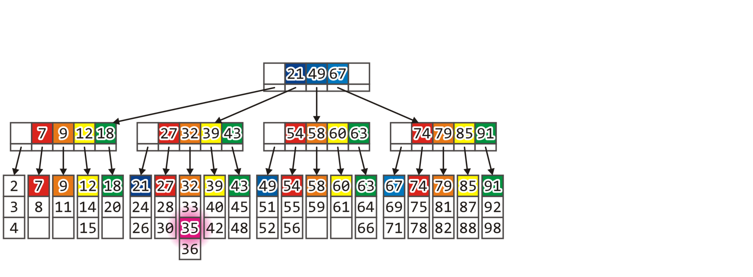
Insert
Consider inserting 35

Slide 77
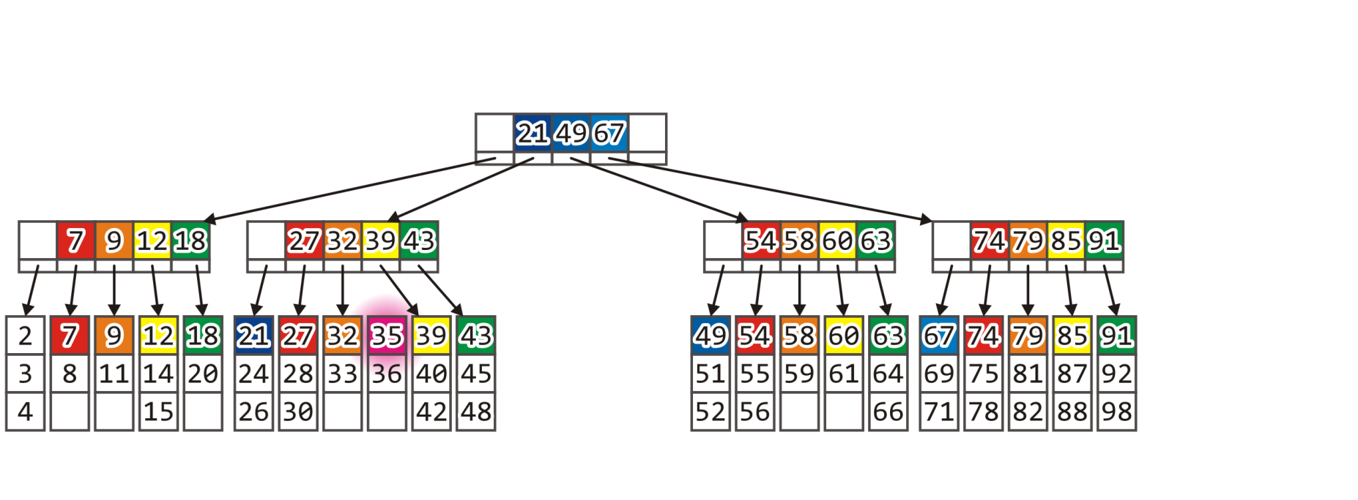
Insert
The leaf block is full, so we split it
The parent block, however, is also full

Slide 78
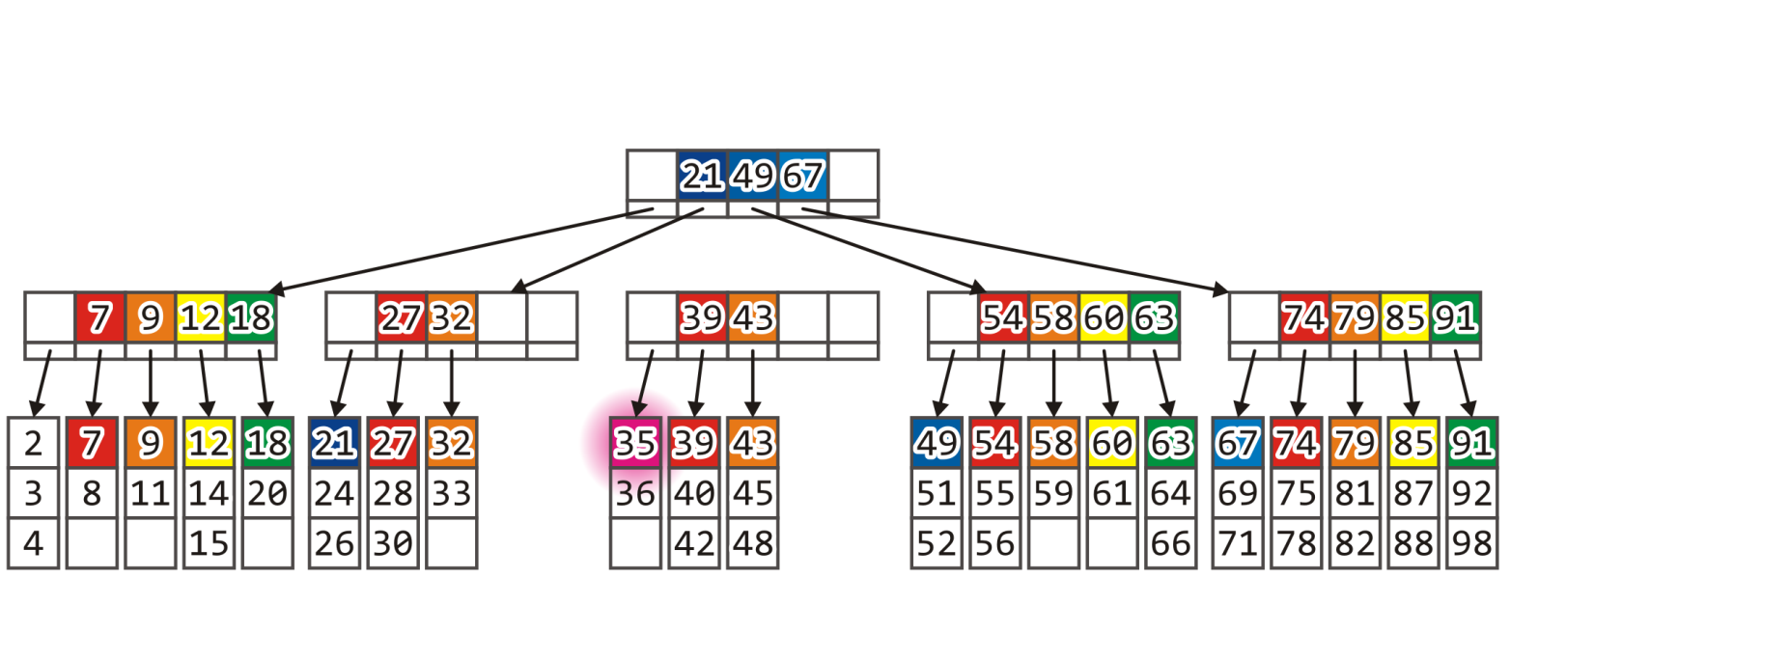
Insert
We can split the parent block in two

Slide 79
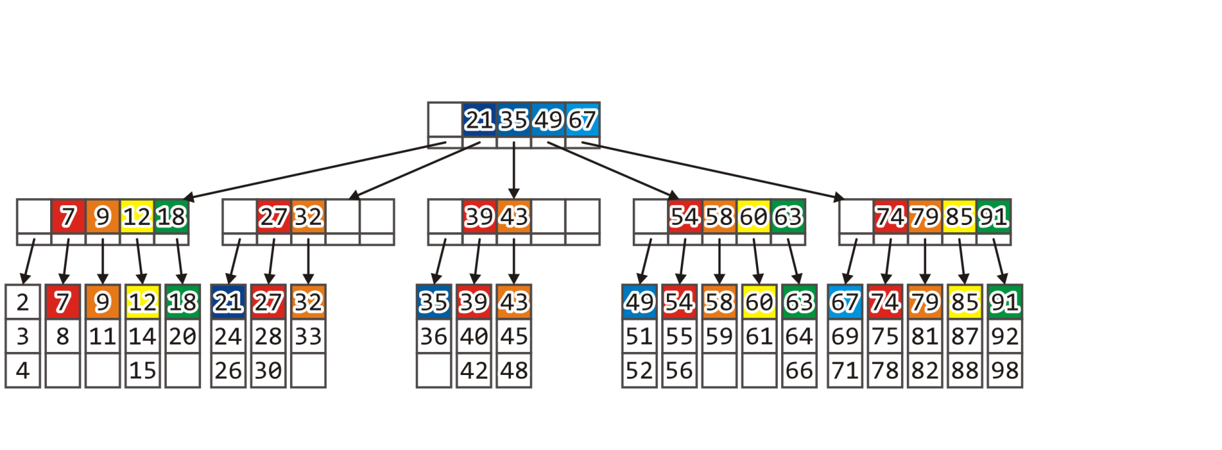
Insert
At this point, the root node must also be updated

Slide 80
Insert
In addition to loading the two blocks, it is now necessary to:
Save the new and the modified leaf blocks,
Save the new and modified internal blocks, and
Save the root.
Total time: 20 ms + 50 ms = 70 ms
Problem: what happens if the parent is full, too?
We must recurse back to the root

Slide 81
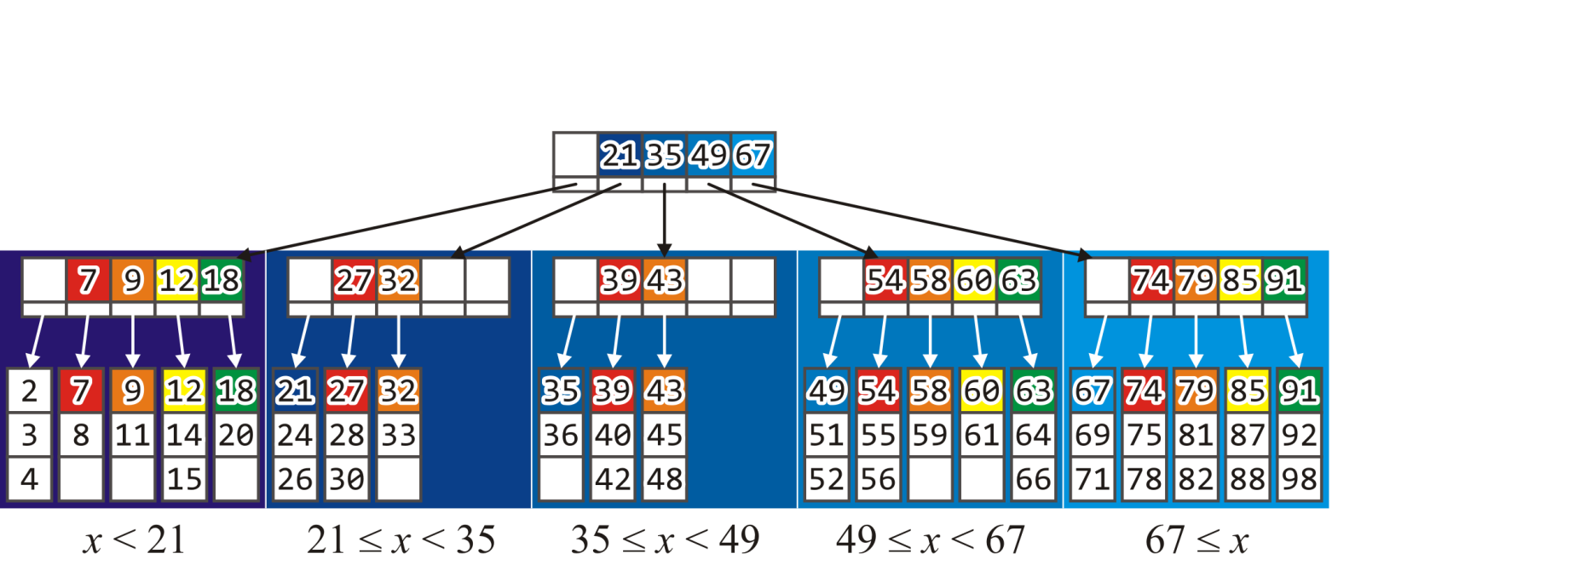
Insert
Once again, the root node is updated allow a successful search for any key

Slide 82

Insert
Consider inserting 86

Slide 83
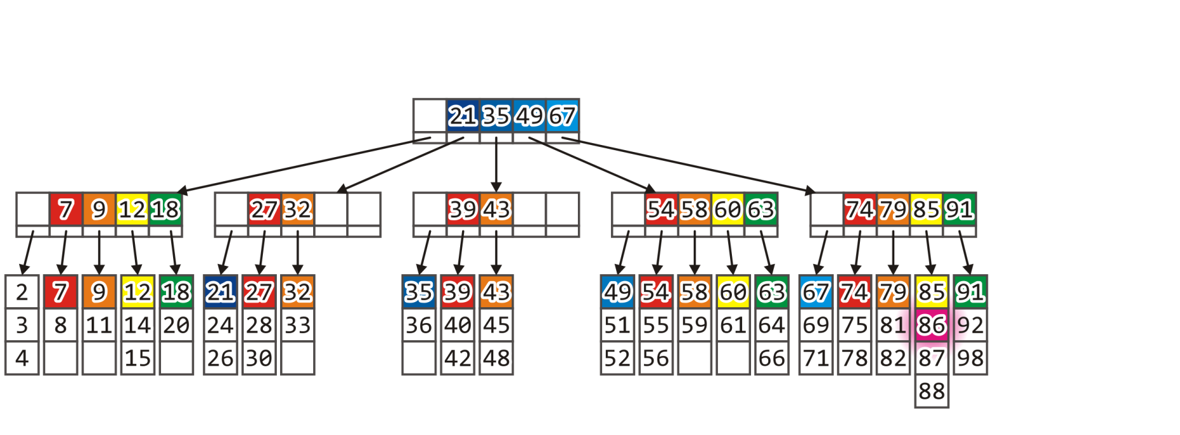
Insert
Again, the leaf block is full, so we must split it

Slide 84
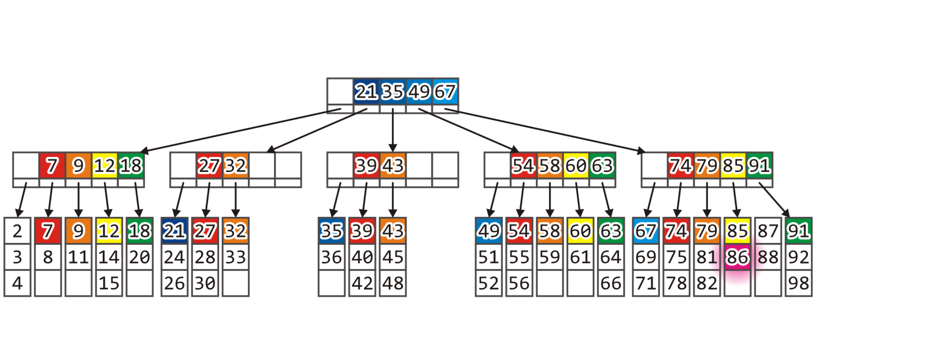
Insert
However, the parent node is also full

Slide 85
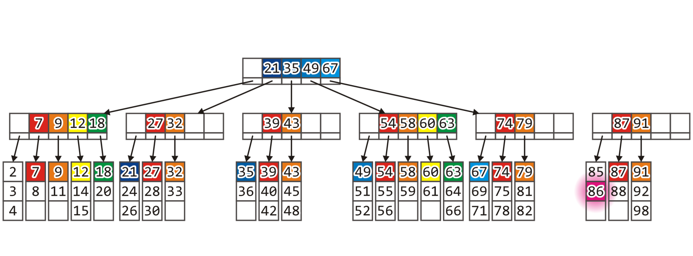
Insert
We must split the parent block as well, but the root node is also full
Split the root node into two nodes

Slide 86
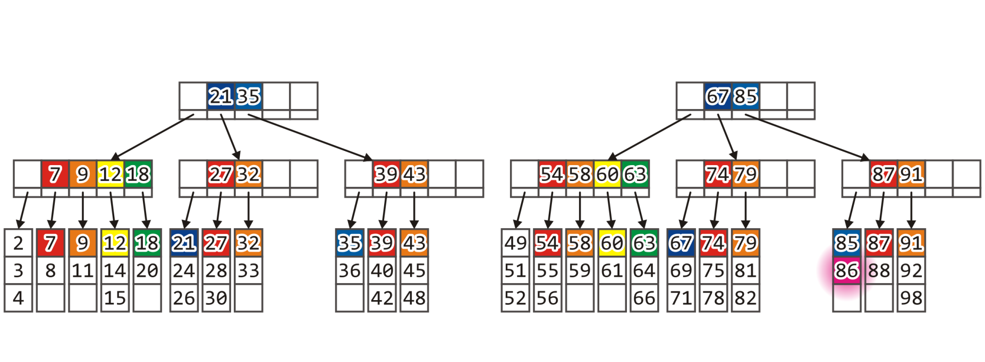
Insert
This, however, is no longer a tree:
In order to create a tree, we must introduce a new root node

Slide 87
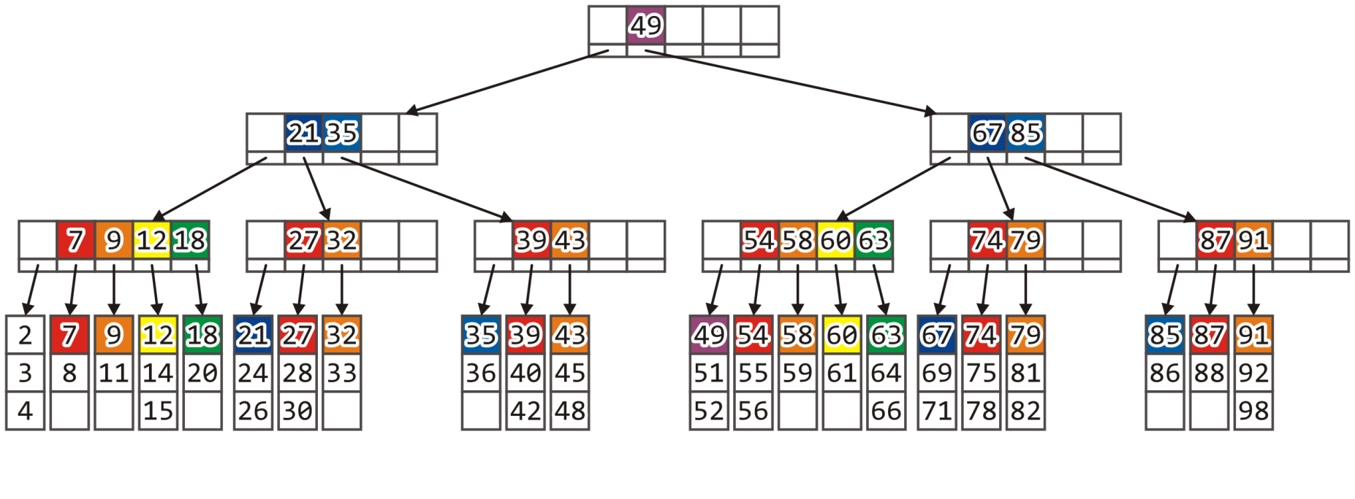
Insert
The root node is only required to have at least two children
We store the smallest entry in the newly created 2nd tree: 49

Slide 88
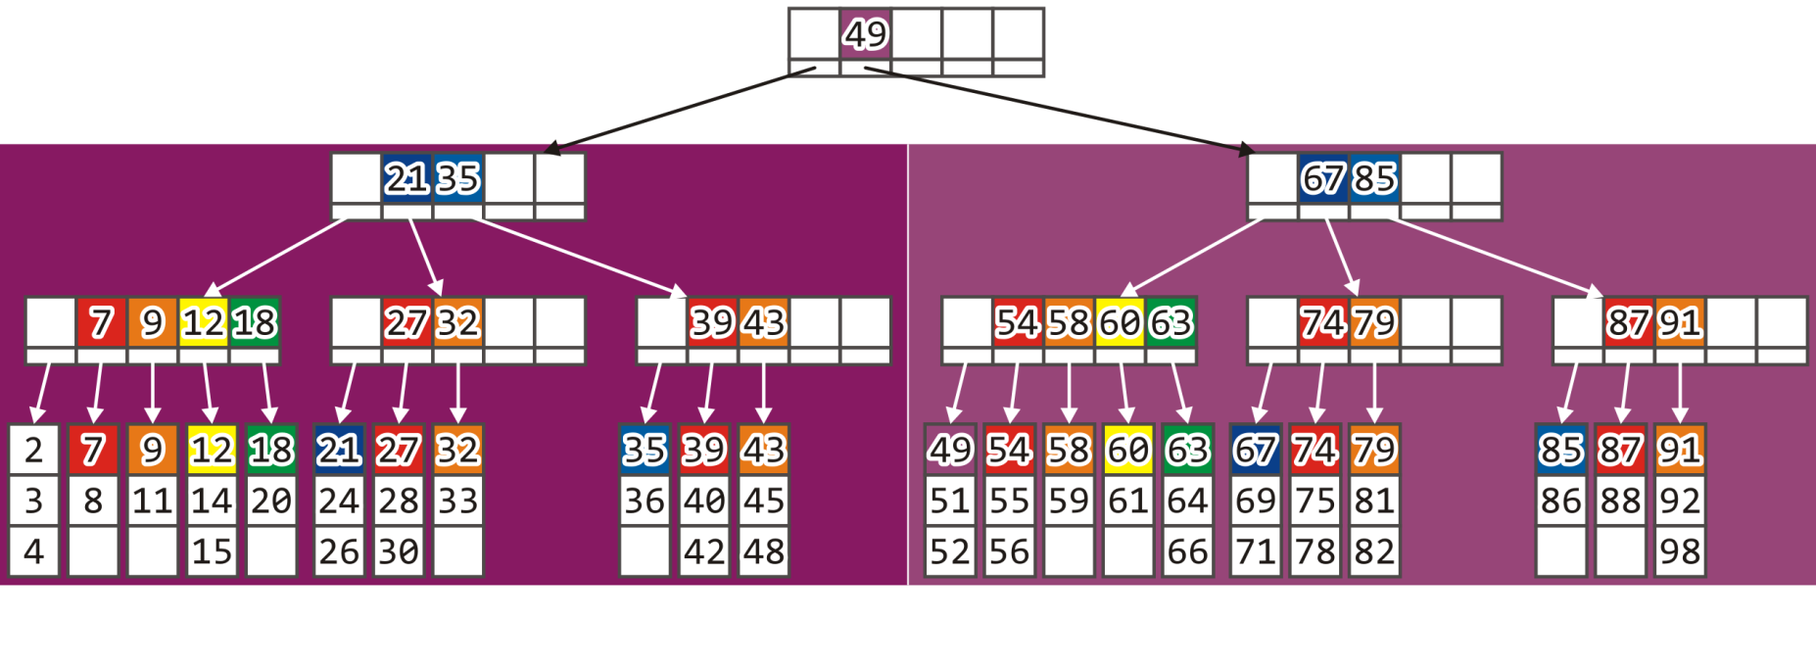
Insert
Everything in the first subtree of the root is less than 49
Everything in the second subtree is greater than or equal to 49

Slide 89
Insert
In addition to loading the two blocks (20 ms), it is now necessary to:
Save the new and the modified leaf blocks,
Save the new and modified internal blocks,
Save the previous root and its new sibling, and
Save the new root node.
Total time: 20 ms + 70 ms = 90 ms

Slide 90
Insert
We can only grow the height of the tree by adding a new root
Thus, all children are now at depth 3

Slide 91
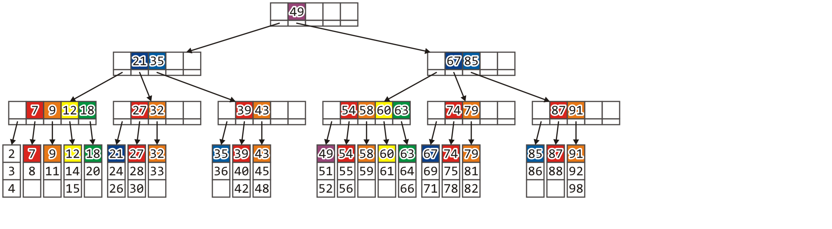
Insert
At this point, the leaves are more sparse as are most internal nodes
10, 19, 34, 37, 38, 62, 89 and 90 could be added to existing leaf blocks
22, 23, 29, 31, 41, 44, 46, 47, 68, 70, 72, 73, 76, 77, 80, 83, 84, 93, … could be added requiring that only the parent be modified

Slide 92
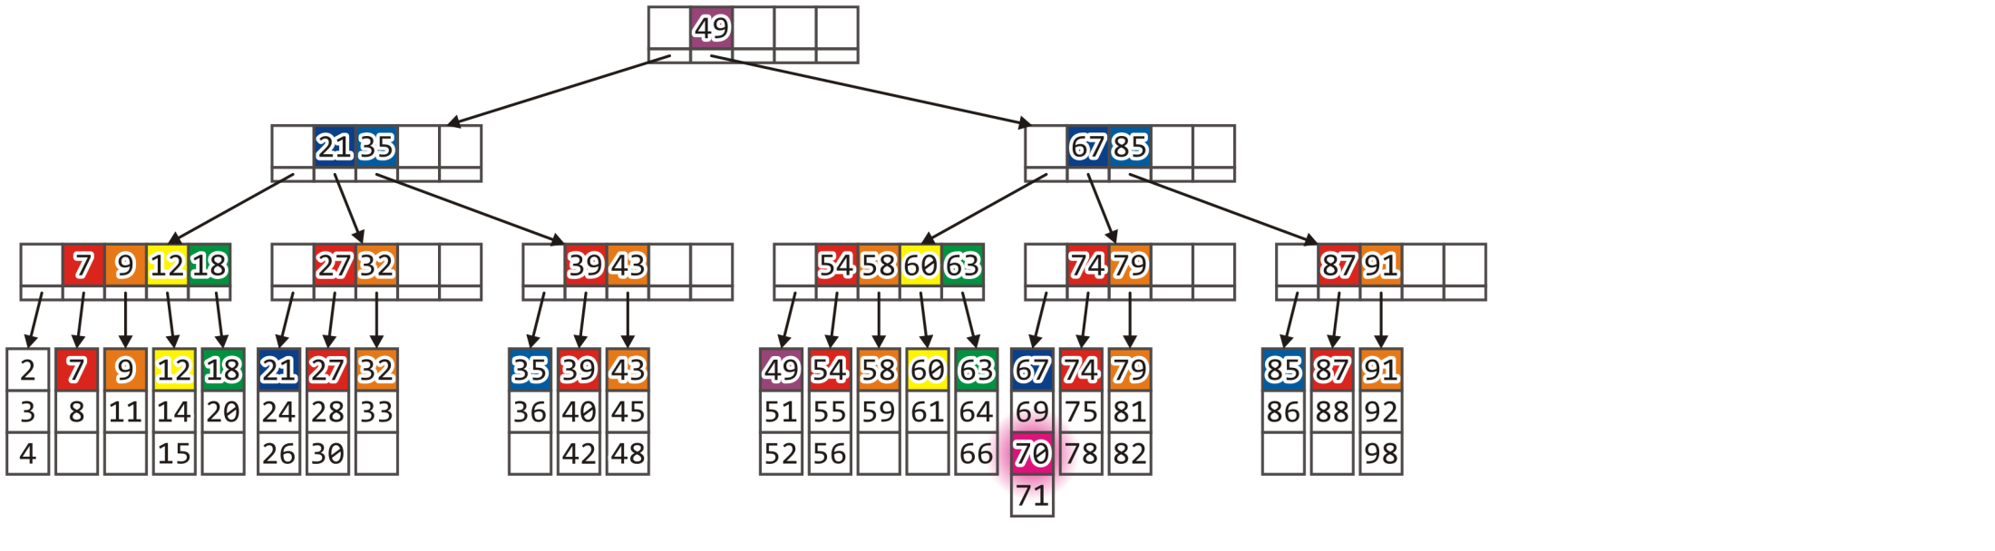
Insert
For example, consider adding 70

Slide 93
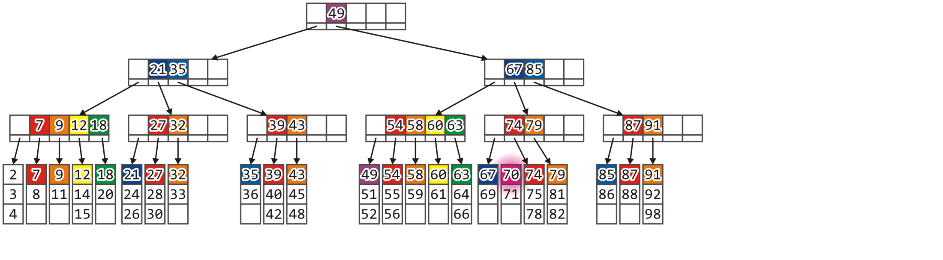
Insert
This only requires that leaf block to be split its parent to be updated

Slide 94

Insert
The addition 0, 1, 13, 16, 17, 50, 57or 65 would still result in the parent being split

Slide 95
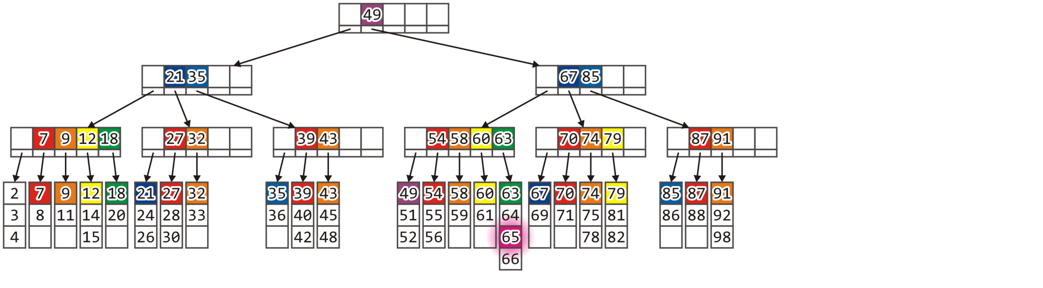
Insert
However, adding 65 fills the corresponding leaf block

Slide 96
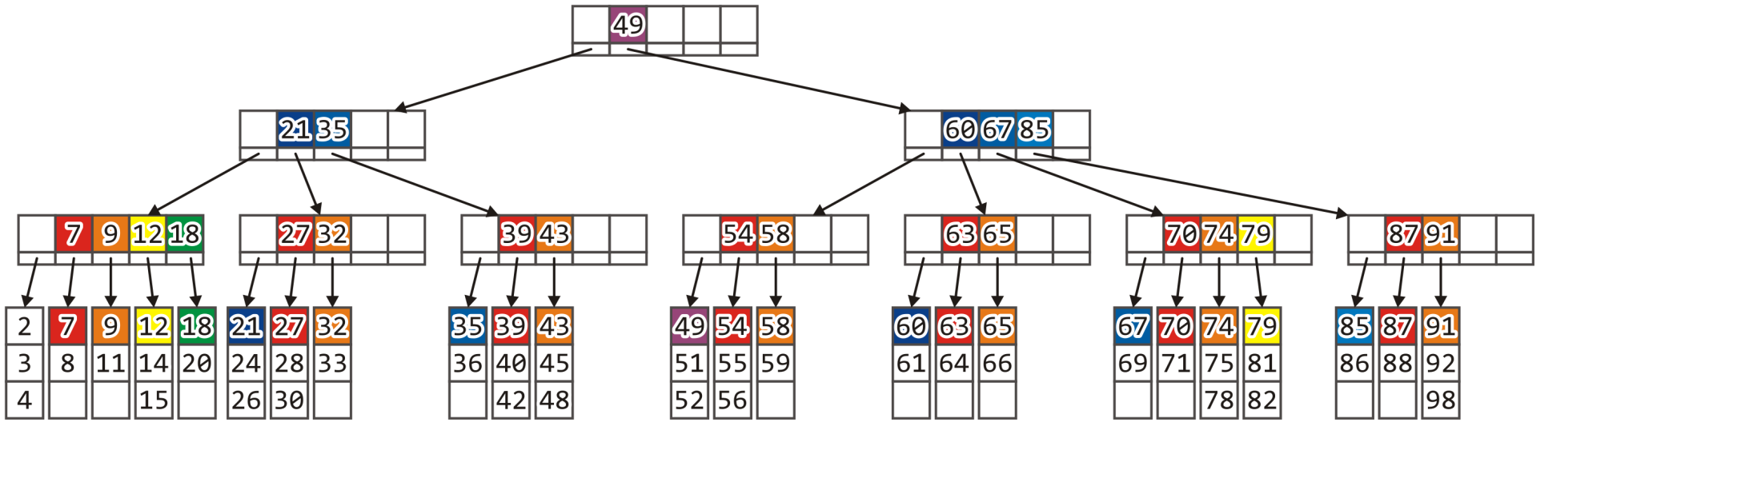
Insert
This would again update the parent

Slide 97
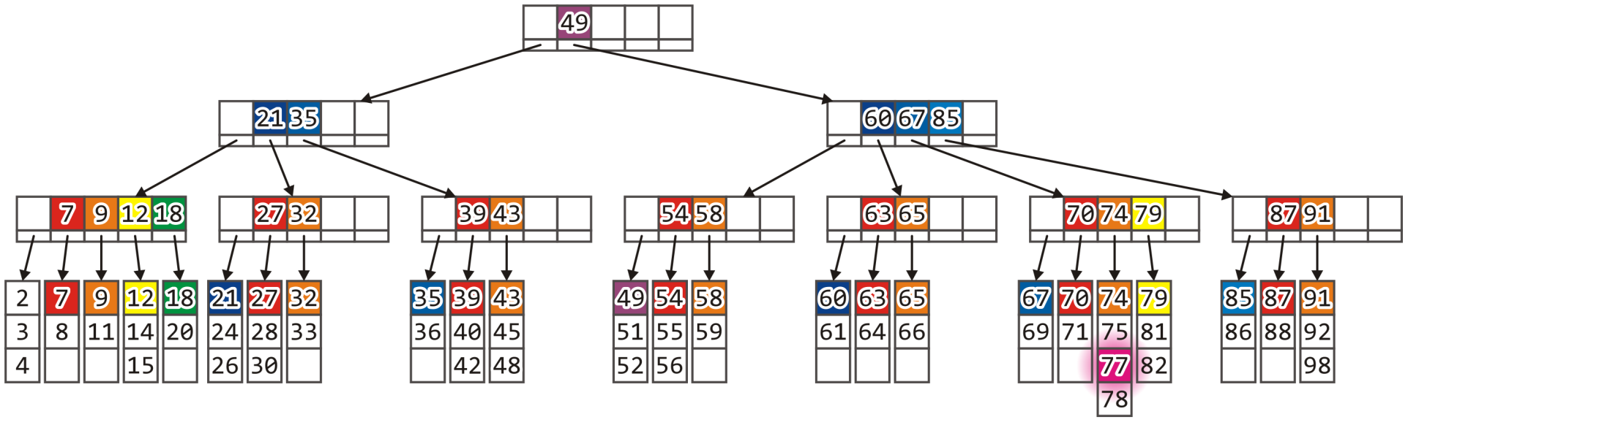
Insert
Inserting 77 would split the leaf block, but only update the parent

Slide 98
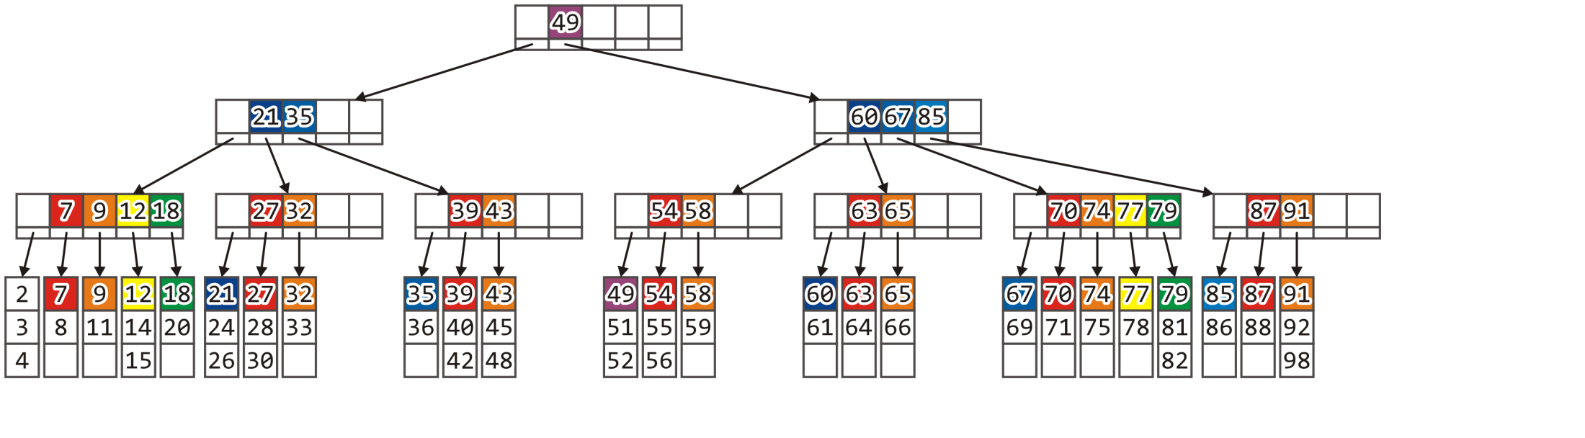
Insert
Finally, we could insert 80 to split that leaf block and its parent

Slide 99

Insert
The leaf is full, but so is its parent

Slide 100
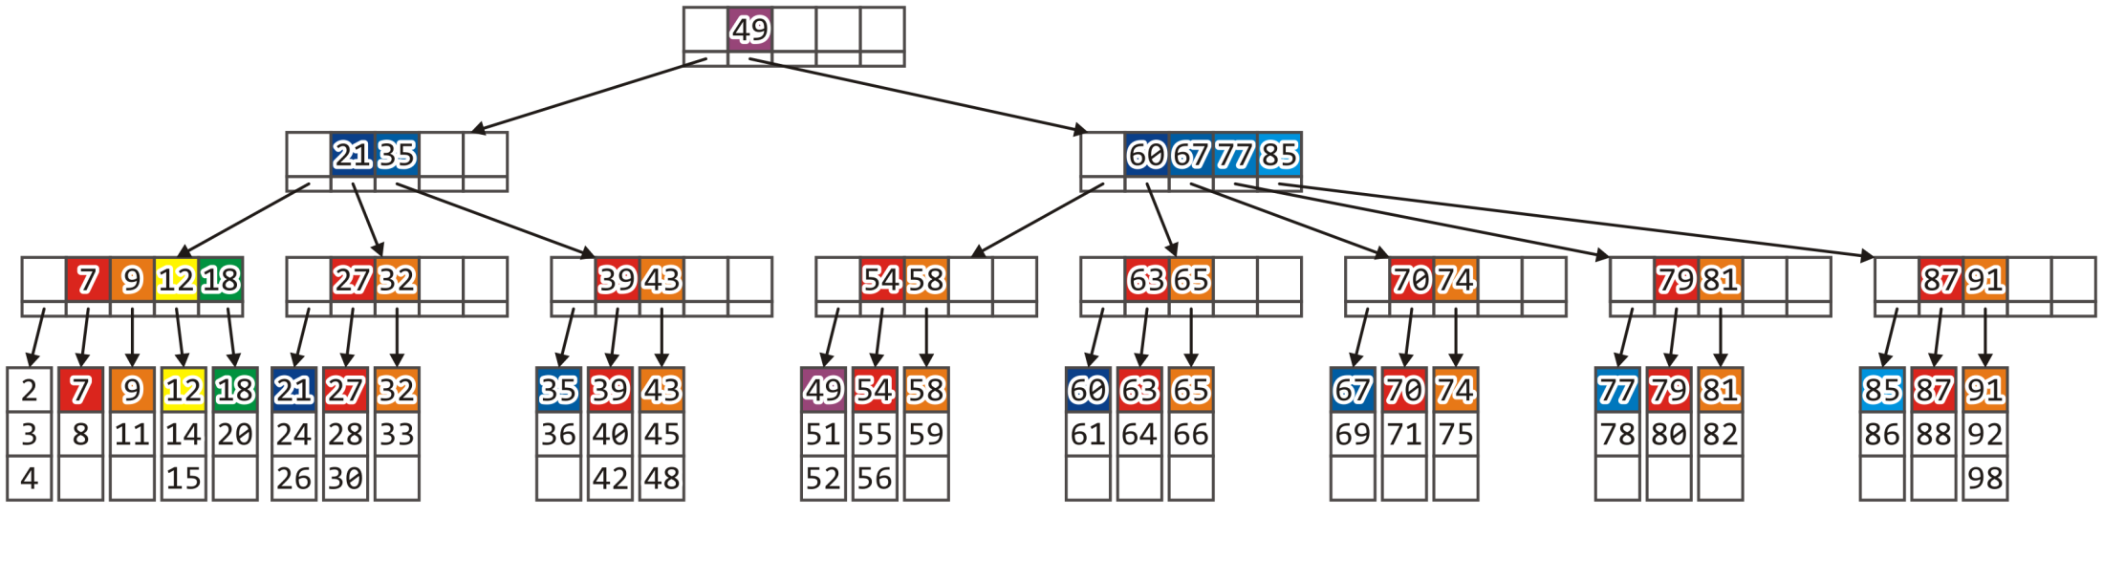
Insert
Again, we would have to split the parent node and update its parent

Slide 101
Insert
At this point, it would seem that such splits occur very often
In reality, recall that with values such as M = 512 and L = 32:
A split of a leaf node would occur, on average, once every 16 insertions
A split of a parent would occur once every 256 splits of a leaf
These are reasonably rare events

Slide 102
Erase
When erasing a record from a B+ tree, it may occur that an insertion will result in a violation in a leaf node:
It end up with < L/2 entries
It would be necessary to either merge or redistribute records between the leaf blocks
Two leaf blocks may have ≤ L records: merge them
Otherwise, they may have > L nodes: redistribute

Slide 103
Erase
Similarly, an internal node may end up with fewer than M/2 children
Ultimately, a root node with two children may see those children merged
This is solved by removing the old root node and defining the newly merged node to be the new root

Slide 104
Erase
Similarly, an internal node may end up with fewer than M/2 children
Ultimately, a root node with two children may see those children merged
This is solved by removing the old root node and defining the newly merged node to be the new root

Slide 105
Erase
To allow easier erasing of records, one other feature is standard with a B+ tree:
The leaf blocks are usually linked in order forming either a singly or doubly linked list
This allows fast access to either the preceding or succeeding child block:
If an erase reduces a leaf block to less than half full, check the neighbouring siblings

Slide 106
Erase
Let’s start with the B+ tree in the following state:

Slide 107
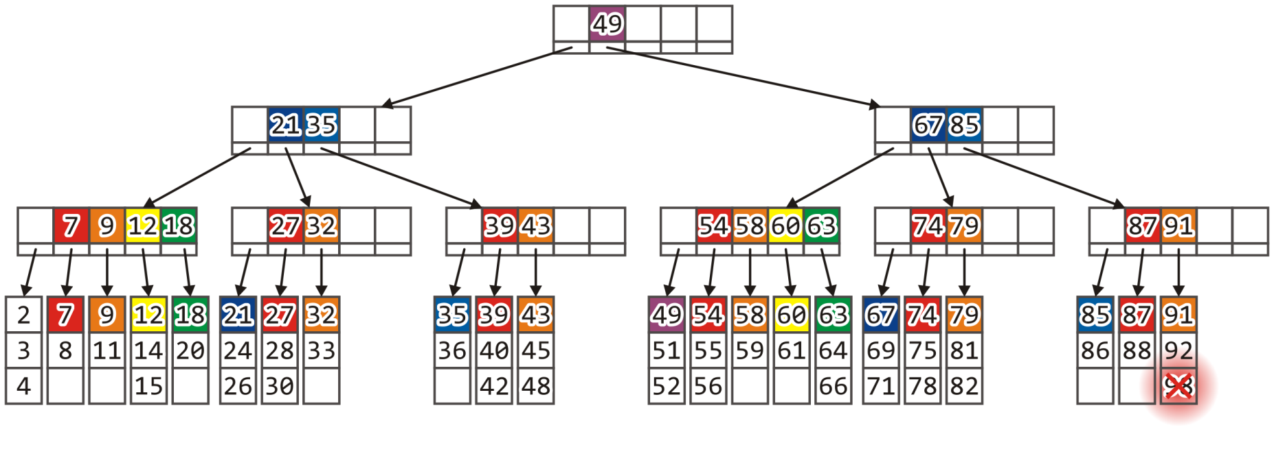
Erase
Erasing 98 (and any associated record) is straight-forward
Remove the record and save the leaf block

Slide 108

Erase
The leaf block is still at least half full

Slide 109
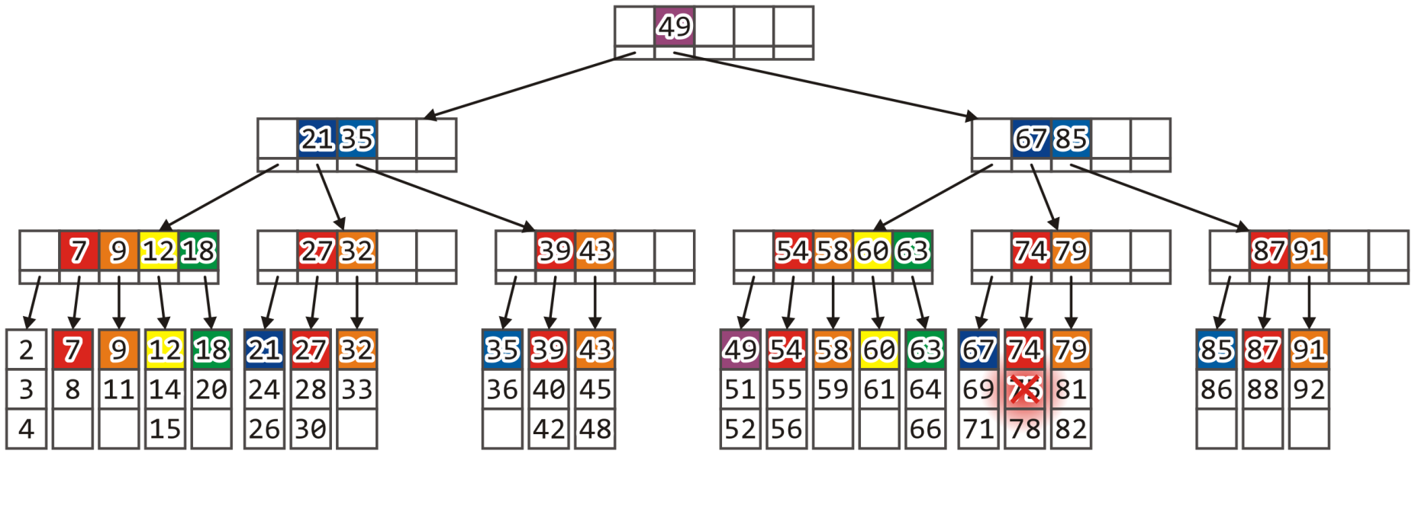
Erase
Removing 75 requires us to move the records in that leaf block up

Slide 110

Erase
The leaf block must now be saved

Slide 111
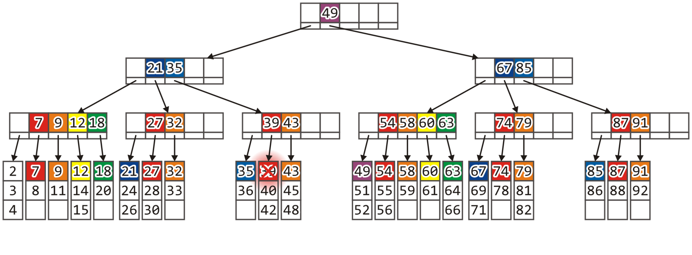
Erase
If we remove record 39, we need to update the leaf block

Slide 112

Erase
But we must also update the parent
A re-insertion of 39 will put it into the leaf block containing 35

Slide 113
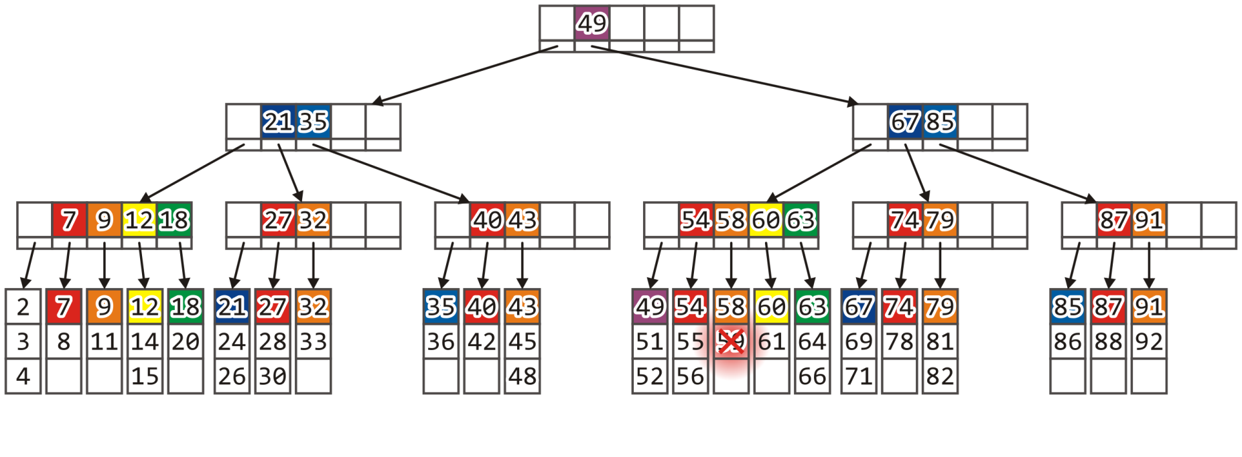
Erase
Remove 59 gives us two choices

Slide 114

Erase
We could access the left sibling and copy over 56
Redistribution

Slide 115
Erase
Alternatively, we could merge that leaf block with the right sibling

Slide 116
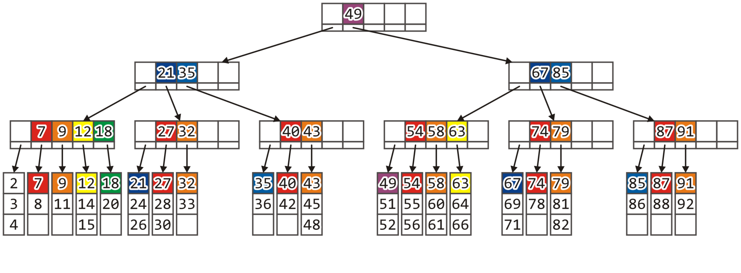
Erase
At this point, the parent node must also be updated

Slide 117
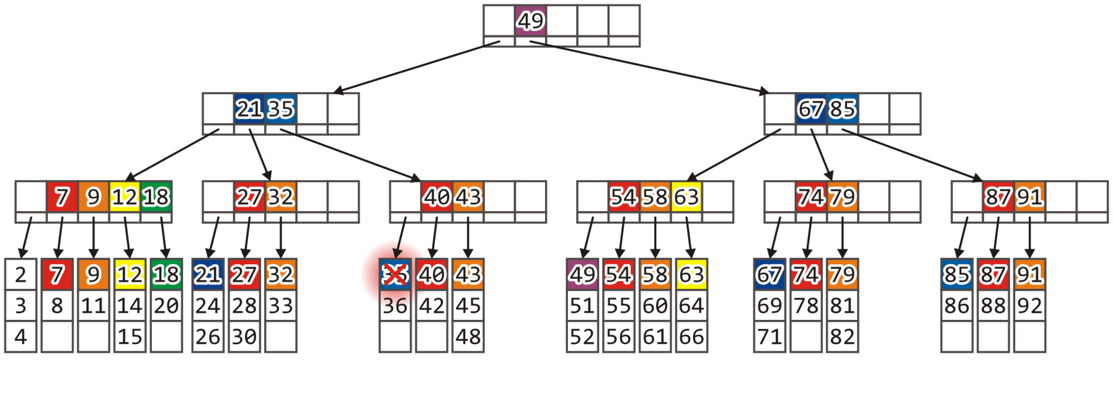
Example: Removal
Erasing 35 would result in another leaf block less than half full
We will merge it with its right sibling—easier to deal with as they share a common parent

Slide 118
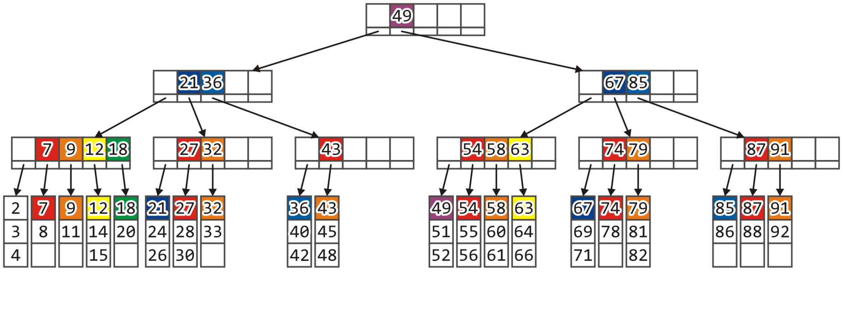
Erase
The parent, however, is now less than half full

Slide 119
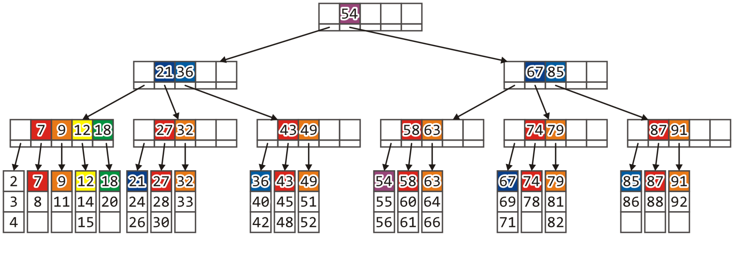
Erase
It might be possible to copy over one leaf block from the next internal node
Redistribution

Slide 120
Erase
The other solution, more reasonable as they share a common parent, is to merge the two internal nodes

Slide 121
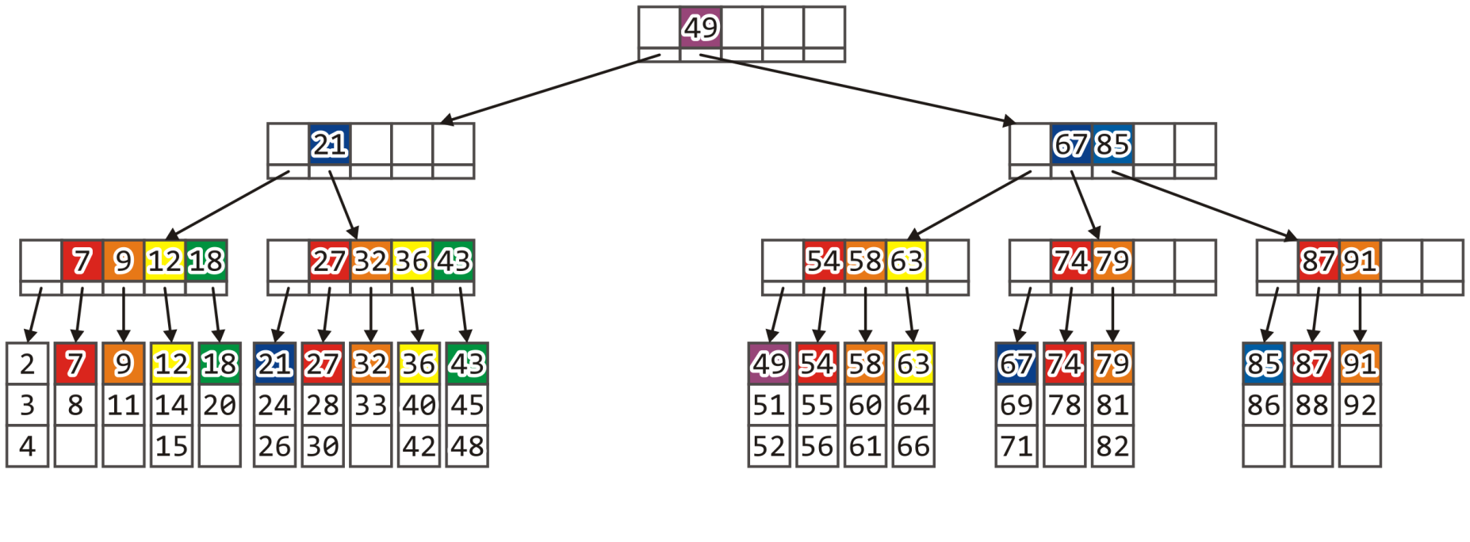
Erase
As before, however, that node is now less than half full
Merge it with its sibling

Slide 122
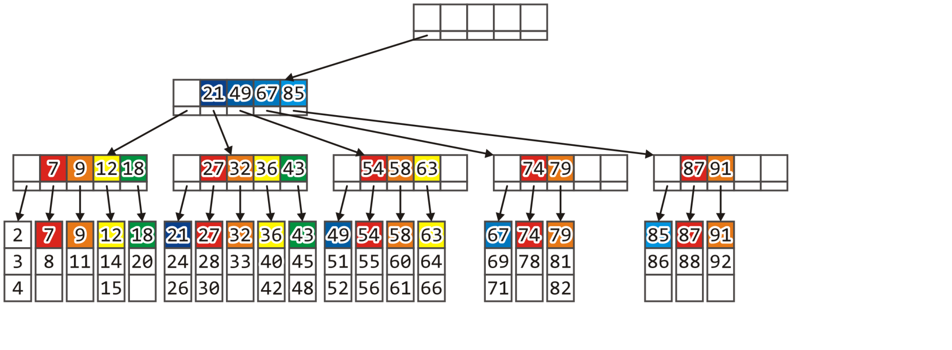
Erase
There is no longer a purpose to the root node:
Delete the old root and assign the one child to be the new root

Slide 123
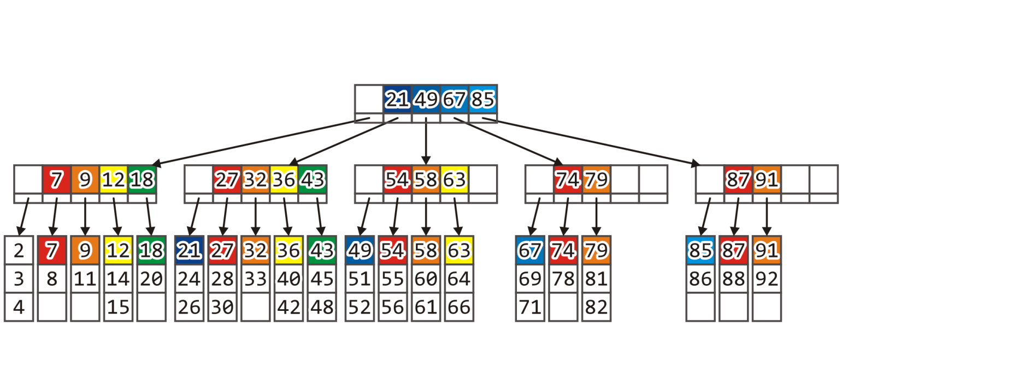
Erase
The result is a B+ tree with one lower height

Slide 124

Erase
Erasing 88 now reduces that leaf block to less than half full: merge

Slide 125

Erase
The parent, too, is now half full: merge

Slide 126

Erase
The final result is a well defined B+ tree

Slide 127
Terminology
The original B tree had records stored at each node:
An M-way tree with all leaf blocks at the same depth and no node (other than the root) half full
Developed by Rudolf Bayer and Edward M. McCreight in 1972
The “B” is for balanced
2-3 trees are B-trees with M = L = 3
2-3-4 trees are B-trees with M = L = 4
Available at http://ece.uwaterloo.ca/~dwharder/aads/Algorithms/
The B+ tree was already in use by 1973

Slide 128
B* Trees
We require that all blocks be half full
Must we be this sparse?
Is there a larger lower bound we can use?
We can require that nodes be 2/3 full
Called a B*-tree
Insertions result in redistributions between both left and right siblings
If both siblings are full, the node and one sibling are split into three, each of which will be 2/3rds full
Erases result in more redistributions
If both siblings are 2/3rds full, merge them into two full nodes

Slide 129
B+ trees
In this topic, we have covered B+ trees:
Used for storing large amounts (GiB) of information
Internal nodes are M-way trees storing pointers with keys
Leaf blocks contain L records with keys
All nodes (except the root) must always be at least half full
Splitting nodes is used for insertions
Redistributions and merging are used for erases
B* trees have less wasted space

Slide 130
References
[1] Cormen, Leiserson, and Rivest, Introduction to Algorithms, McGraw Hill, 1990, Ch. 19, p.381-99.
[2] Weiss, Data Structures and Algorithm Analysis in C++, 3rd Ed., Addison Wesley, §4.7, p.159-64.

Slide 131
References
Wikipedia, http://en.wikipedia.org/wiki/B+_tree
[1] Cormen, Leiserson, and Rivest, Introduction to Algorithms, McGraw Hill, 1990, Ch. 19, p.381-99.
[2] Weiss, Data Structures and Algorithm Analysis in C++, 3rd Ed., Addison Wesley, §4.7, p.159-64.
These slides are provided for the ECE 250 Algorithms and Data Structures course. The material in it reflects Douglas W. Harder’s best judgment in light of the information available to him at the time of preparation. Any reliance on these course slides by any party for any other purpose are the responsibility of such parties. Douglas W. Harder accepts no responsibility for damages, if any, suffered by any party as a result of decisions made or actions based on these course slides for any other purpose than that for which it was intended.

